Slide 1

Simple past

Slide 2

Timeline

Slide 3
Timeline
I will sleep early today.
I sleep early on Mondays.

Slide 4
Timeline
I will sleep early today.
I sleep early on Mondays.
I slept early yesterday.

Slide 5
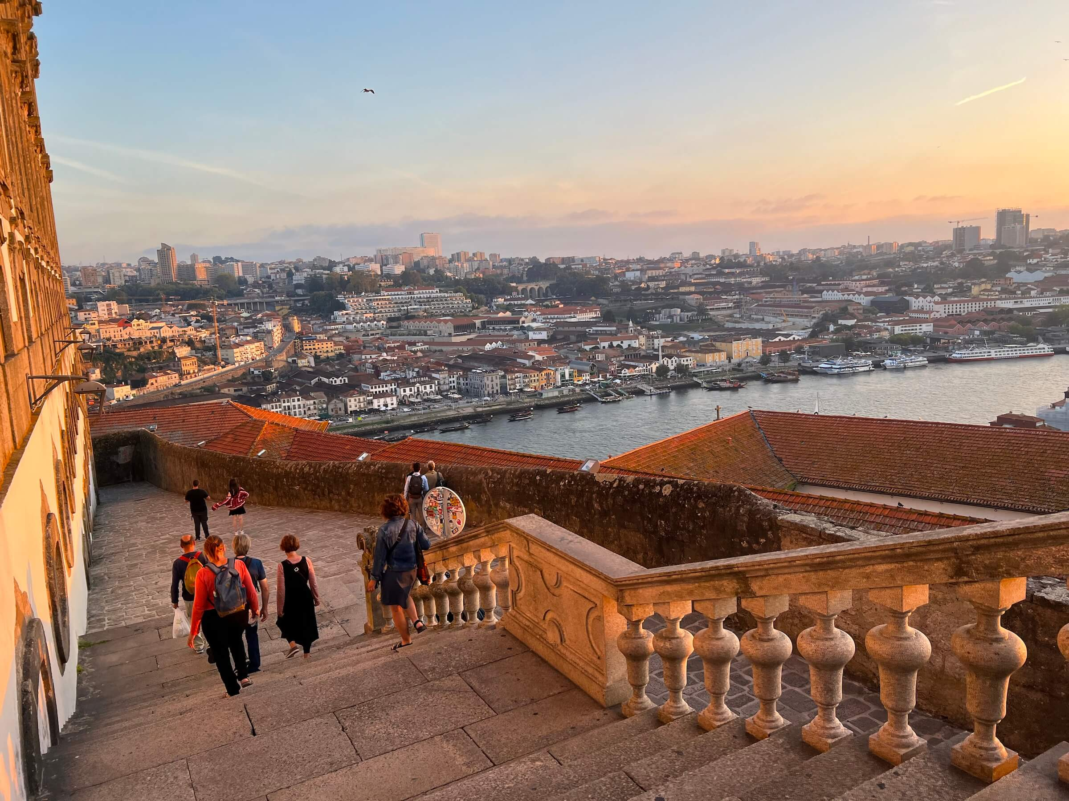
Simple Past (Passado Simples)
Actions in the past
I went to Lisbon in 2019.
I visited Portugal some years
ago.

Slide 6
Formas do Simple Past
-ED
Irregular forms

Slide 7
Formas do Simple Past
-ED:
Visit = Visited Open = Opened Cook = Cooked
Live = Lived Ask = Asked Cry = Cried
Irregular forms
Make = Made Do = Did Sing = Sang
Eat = Ate Sleep = Slept Say = Said

Slide 8
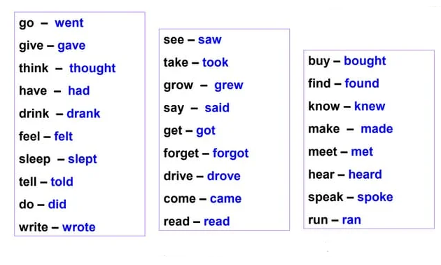
Irregular Verbs

Slide 9
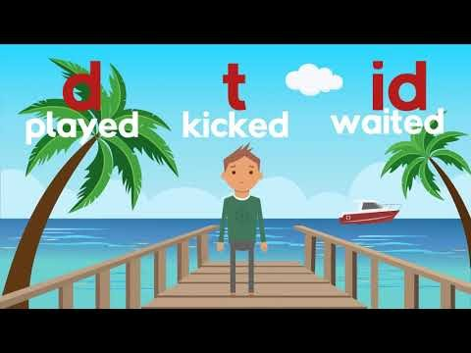
Sons
/ED/
/ET/
/ID/

Slide 10
To be in the past
I am I was
You are You were
He is He was
She is She was
It is It was
We are We were
They are They were

Slide 11
How to make questions in the past
Do you go to the school?
Did you go to the school (yesterday)?
Do you watch the movies?
Did you watch the movies (last week)?

Slide 12
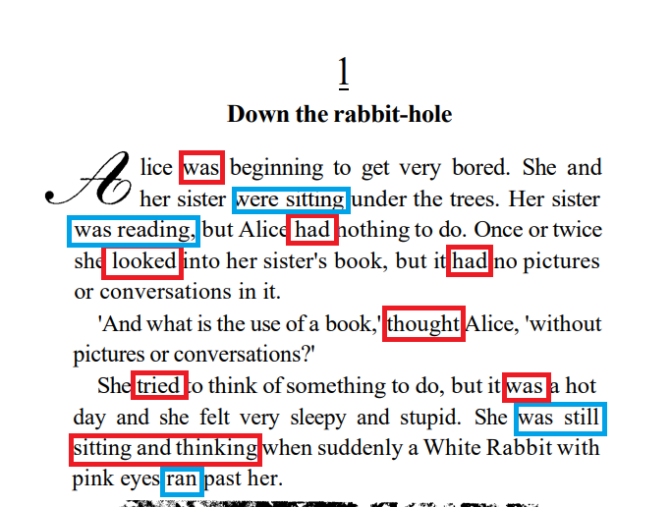
Os livros são quase sempre narrados no passado

Slide 13
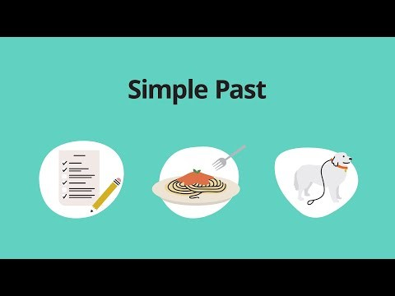
Review

